Slide 1




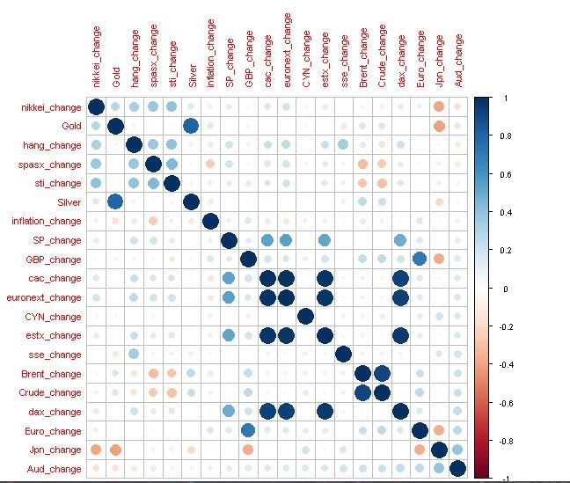
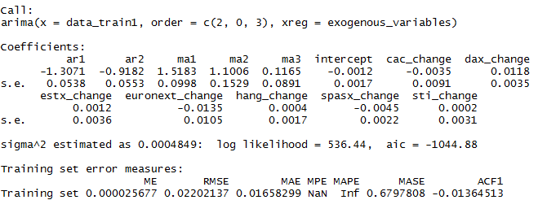
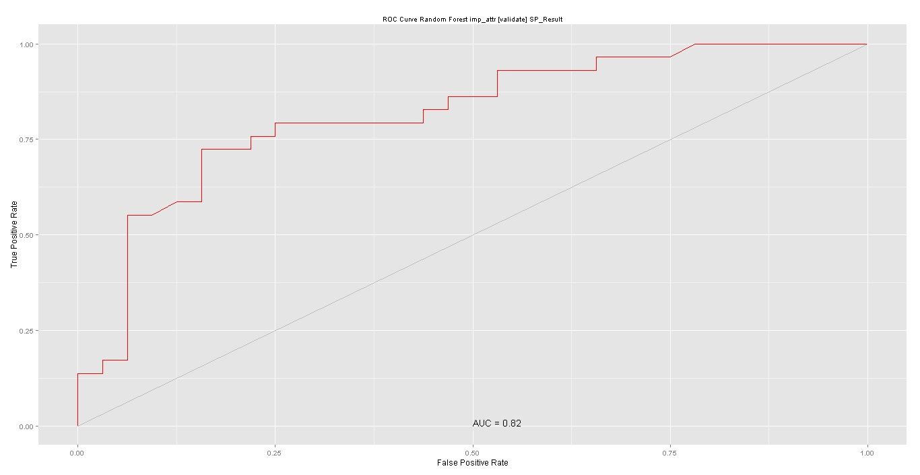
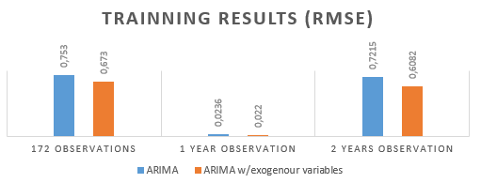
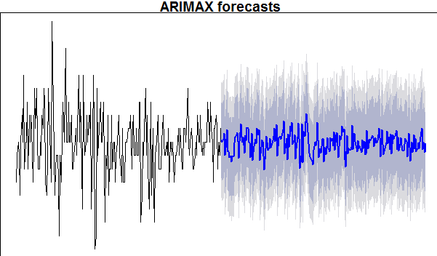

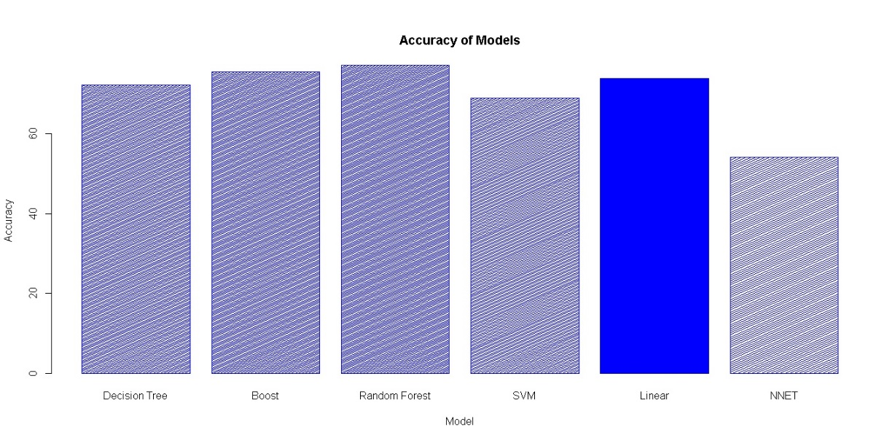


Stock Forecasting Based on Interrelated Stock indexes
RIT CSCI - Introduction to Big Data Project
Dinesh Gudi, Gustavo Kondo, Kamaleshwar Panapakam
Summer 2015
Project Overview
The figure 3 presents the h=25 prediction of this model where the dark and light blue zones represent 99% and 95% of confidence respectively.
The financial market is a valuable resource for people and companies try to augment their returns. The financial market is a market where it is plausible to trade monetary products with low transaction costs. The capital market is acknowledged to be a high-risk market. routines. The present project proposes a data analysis approach using a particular methodology and an algorithm to reduce the risk on a stock market. Exchanges. In this article, we predict the outcome of S&P stock index by using stock related data. This paper also presents the comparison of different machine learning algorithms for attaining the best results.
Figure 5: ROC for Random Forest(JPG)
In addition, as shown in figure 6. For the Auto Regression analysis the ARIMA(2,0,3).
Figure 2: Results ARIMA (2,0,3) with exogenous variables(JPG)
Figure 2: Correlation of various features (JPG)
Data Collection and Preprocessing
Model Training - Classification
The global stock indexes are accumulated from various sources such as YAHOO Finance [1] , investing.com [2] and research.stlouisfed.org [3]. The Data consolidated for this analysis includes features such as Nikkei, Hang Seng, SP, EUR/USD, GBP/USD, AUD/USD, YUAN/USD, Crude oil, Brent, Gold, DAX, CAC, STI, SSE, S&P/ASX, ESTX, EURONEXT and inflation. The data with the class attribute i.e. SPchange categorized with a class level of two (Bullish / Bearish) serves an input to the classification model. This data is preprocessed and consolidated. The following table shows the preprocessed data.
A correlation of all the gathered data is plotted. Input for the training process includes only a subset of the strongly correlated features to the class attribute i.e. SPChange. As shown in Figure 2, only Nikkei, inflation, CAC, DAX, ESTX, EURONEXT, HANG SENG, S&P/ASX, STI are chosen for the model training.
Data prepared is fed into different classification models such as SVM, Decision Trees, Ada Boost, Random Forests all with default parameters. Date attribute is ignored during the training phase since it is unique for each observation which doesn’t play any role in the prediction step.
SVM with default parameters results in accuracy of 68.9%. SVM with polydot or vanilladot increases the accuracy to 73.8%.
Figure 6: Auto Regression Results (RSME)
References
[1] http:finance.yahoo.com//.
[2] http://www.investing.com///.
[3] https://research.stlouisfed.org///.
[4] K. Daigo and N. Tomoharu. Stock prediction using multiple time series of stock prices and news
articles. In Computers Informatics (ISCI), 2012 IEEE Symposium on, pages 11–16, March 2012.
[5] A. Gupta and B. Dhingra. Stock market prediction using hidden markov models. In Engineering and Systems (SCES), 2012 Students
Conference on, pages 1–4, March 2012.
[6] K. Ryota and N. Tomoharu. Stock market prediction based on interrelated time series data.
In Computers Informatics (ISCI), 2012 IEEE
Symposium on, pages 17–21, March 2012.
[7] S. Shen, H. Jiang, and T. Zhang. Stock market
forecasting using machine learning algorithms.
Figure 3: Results ARIMA (2,0,3) with exogenous variables(JPG)
Results
Model Training - Auto Regression
As shown in Figure 4. Random Forests performed better than the other classification models followed by Boost Ada and Linear models. Figure 5. Shows the Precision chart for Random Forest. The Area Under Curve (AUC) for Random Forest is around 82%.
As an alternative model, the auto-regression analysis was made. To do that, the ARIMA model was used in three different ways, an ARMA model, an ARIMA model and an ARIMA model using exogenous variables. The best attributes are identified by various steps. The analysis was made with a small dataset of only 172 observations. The second analysis were made with a dataset correspondent to a role stock price year. And the third study was made using two stock price years. The approach that showed the best RMSE results were the ARIMA(2,0,3) with the combination of exogenous variables using the one-year dataset. The model showed an RMSE of 0.022 as presented on figure 2, considering the target attribute variation of -4.13.
Required Software
Figure 4: Correlation of various features (JPG)
R software was used as the statistical software to make all the statistical analysis, process and model the datasets.
Vista is the operating system used to collect the data and run all the software.

